Slide 1
Chapter 5 - Relational Database Design
First Normal Form
Pitfalls in relational database design
Functional Dependencies
Armstrong Axioms
2nd, 3rd, BCNF, and 4th normal form
Decomposition, Desirable properties of decomposition
Overall database design process

Slide 2
Pitfalls in relational database design
Redundancy of data
Unable to express certain information
Wastage of storage

Slide 3
Anomalies
Redundant information
Insert anomalies
Delete anomalies
Update anomalies
Null values in tuple
Generation of Spurious tuples

Slide 4
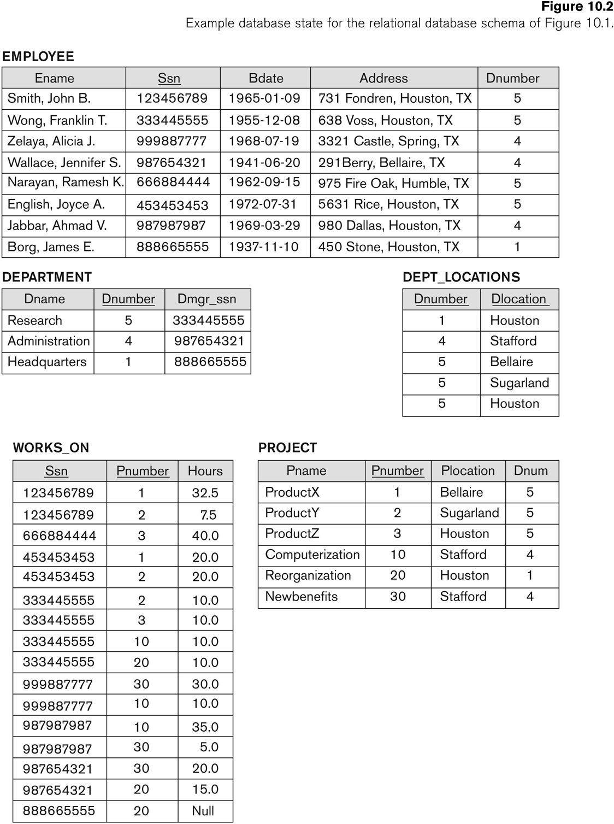
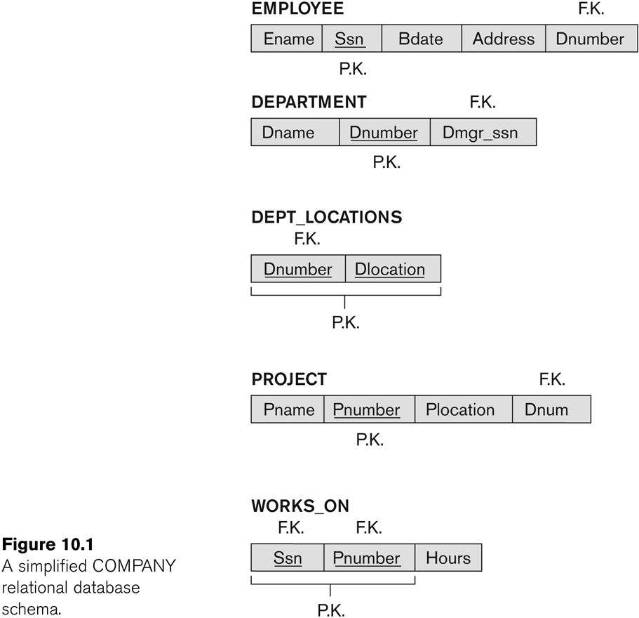
For exa

Slide 5
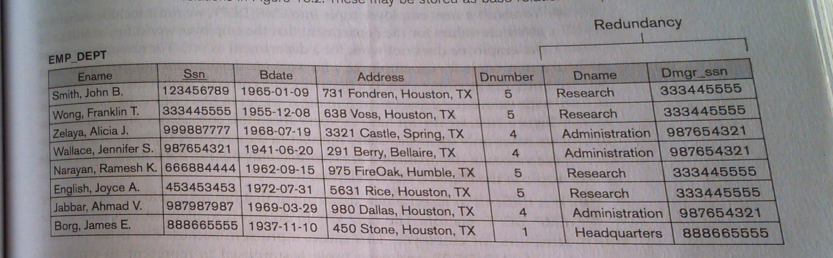

Slide 6
Redundant Information in Tuples and Update Anomalies
The previous example not only waste spaces but also cause some anomalies:
  Insert Anomaly
  Delete Anomaly
  Modify Anomaly

Slide 7

2. Redundant Information in Tuples and Update Anomalies
Consider the relation:
Insert Anomaly:
  For a new employee, you have to assign NULL to projects
  Cannot insert a project unless an employee is assigned to it.

Slide 8
2. Redundant Information in Tuples and Update Anomalies
Consider the relation:
Delete Anomaly:
  If we delete from EMP_DEPT an employee tuple that happens to represent the last employee, the information containing that department is lost from the database

Slide 9
2. Redundant Information in Tuples and Update Anomalies
Consider the relation:
Modify Anomaly:
  If we change the value of the manager of department 5, we must update the tuples of all employees who work in the department

Slide 10
3. Null Values in Tuples
As far as possible, avoid placing attributes in a base relation whose values may frequently be NULL
For example: if only 10% of employees have individual offices, DO NOT include a attribute OFFICE_NUMBER in the EMPLOYEE relation
Rather, a relation EMP_OFFICES(ESSN, OFFICE_NUMBER) can be created. (just like WEAK entity type)

Slide 11
Generation of Spurious Tuples
Let us consider two relation schema
Emp_Locs(ename, plocation) Emp_proj1(eno, pnumber, hours, pname, plocation)
If we attempt a natural join operation on above relation schema, the result produces many more tuples than the original set of tuples. Additional tuples that were not there in Emp_proj are called spurious tuples because they represent wrong information which is not valid

Slide 12
Guidelines For Relation Schema
Guideline 1 – Design a relation schema so that it is easier to explain its meaning. Do not combine attributes from multiple entity types and relationship types into a single relation
Guideline 2 – Design the base schema so that no insertion, deletion, or modification anomalies are present in the relations
Guideline 3 – As far as possible, avoid placing attributes in a base relation whose values may frequently be null. If nulls are unavoidable make sure that they apply in exceptional cases only and do not apply to majority of the tuples in the relation
Guideline 4 – Design relation schemas so that they can be joined with equality conditions on attributes that are either primary keys or foreign key that guarantees that no spurious tuples are generated

Slide 13
Functional Dependencies
It is a constraint between two sets of attributes from the database. Let us consider that our relation schema has n attributes A₁, A₂, . . ., A_{n}. The whole database is described by a single universal relation schema
R = {A₁, A₂, . . ., A_{n}}
A functional dependency denoted by X→Y between two sets of attributes X and Y that are subsets of R specifies a constraint on the possible tuples that can form a relation state r of R. The constraint is for any two tuples t₁ and t₂ in r that have t₁ [X] = t₂[X] must also have t₁ [Y] = t₂[Y]

Slide 14
Functional Dependencies
Values of Y component of a tuple in r depend on, or are determined by, the values of the X component OR The values of X component of a tuple uniquely or functionally determine the values of Y component
There is a functional dependency from X to Y or Y is functionally dependent on X
The abbreviation of functional dependency is FD or f.d.

Slide 15
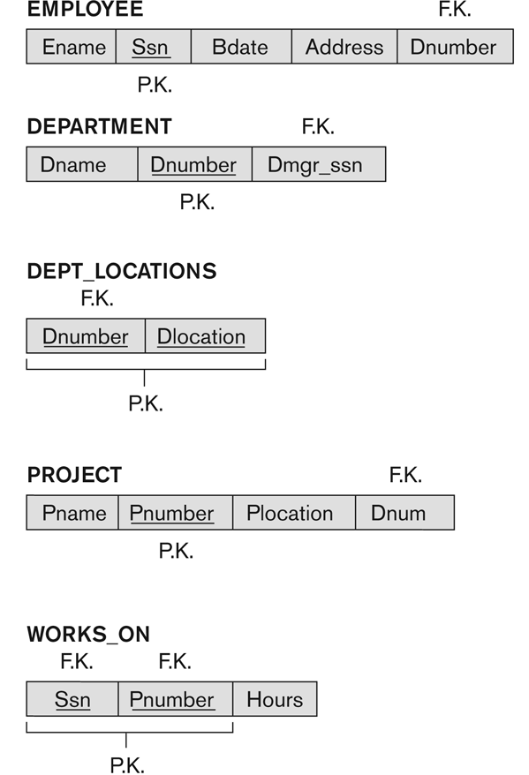
Functional Dependency
Social security number determines employee name
  SSN -> ENAME
Project number determines project name and location
  PNUMBER -> {PNAME, PLOCATION}
Employee ssn and project number determines the hours per week that the employee works on the project
  {SSN, PNUMBER} -> HOURS

Slide 16
Functional Dependencies
If the values of an attribute “Marks” is known then the values of an attribute “Grade” are determined since
Marks→ Grade
X is called the left-hand side of FD, and Y is called the right-hand side

Slide 17
Inference Rules for Functional Dependencies
Let F is the set of functional dependencies that are specified on relation schema R. However, numerous other dependencies can be deduced or inferred from the FDs in R. In real life it is impossible to specify all them for given situation
e. g. if each department has one manager, so dept_no uniquely determines manager_no, and a manager has a unique phone number then manager_no uniquely determines mgr_phone, these two dependencies together imply that dept_no determines mgr_phone. This is an inferred FD and need not be explicitly stated.
If A → B and B → C, then we can infer that A → C

Slide 18
Closure of Functional Dependencies
The set of all dependencies that include F as well as all dependencies that can be inferred from F is called closure of F. It is denoted by F⁺
Example:
F = {eno {ename, dob, address, dnumber},
dnumber {dname, dmgrno}
Inferred functional dependencies are
eno {dname, dmgrno}
eno eno
dnumber dname

Slide 19
Inference Rules for Functional Dependencies
A set of rules that can be used to infer new dependencies from a given set of dependencies
We use the notation F = X Y to denote that the functional dependency X Y is inferred from the set of functional dependencies F

Slide 20
Inference Rules for Functional Dependencies
IR1 (Reflexive rule) If X Y then X Y
IR2 (Augmentation rule) {X Y} =XZ YZ
IR3 (Transitive rule) {X Y, Y Z} = X Z
IR4 (Decomposition or Projective rule)
{X YZ} = X Y
IR5 (Union or Additive rule)
  {X Y, X Z} = {X YZ}
IR6 (Pseudo transitive rule)
{X Y, WY Z} = {WX Z}

Slide 21
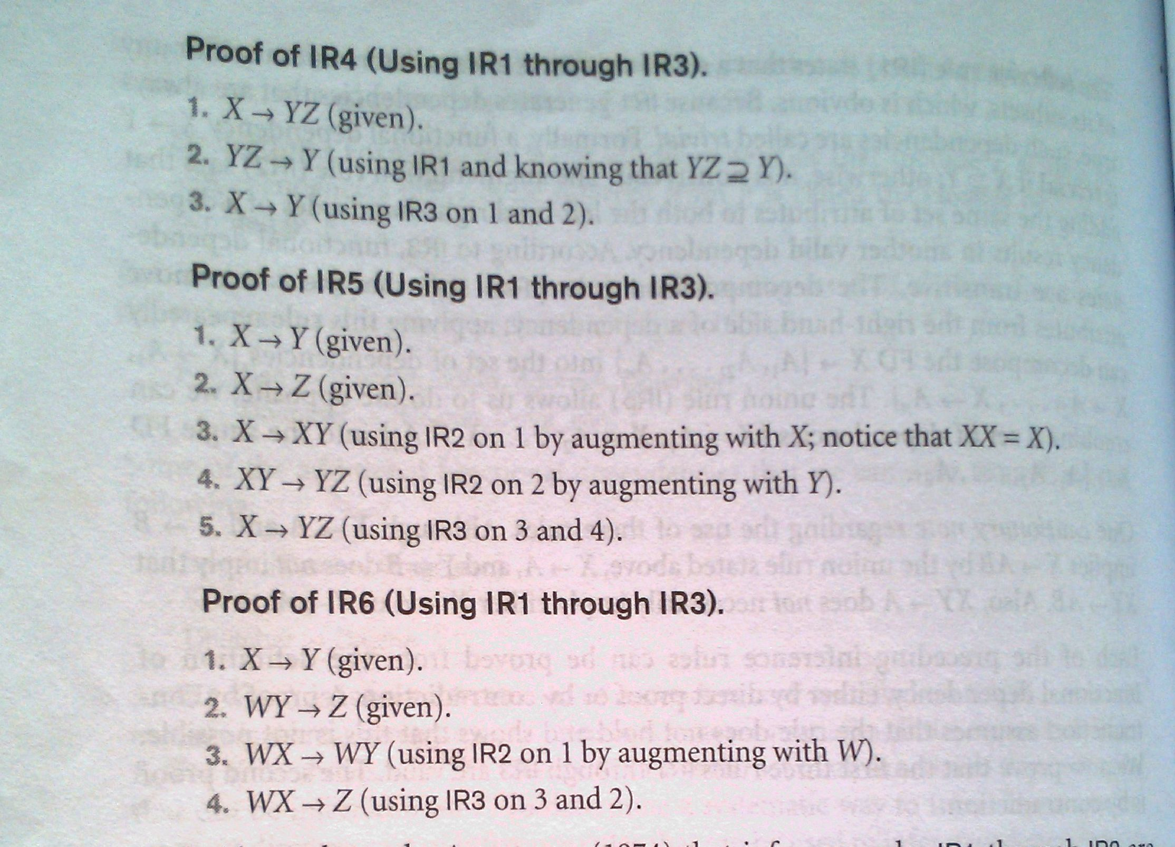

Slide 22
Types of Functional Dependencies
Full Functional dependency
Partial Functional dependency
Transitive Functional dependency

Slide 23
Definitions of Keys and Attributes Participating in Keys
Key- The difference between Key and Super key is that a key has to be minimal.
{ssn}
Super Key– A key K is a super key with the additional property that removal of any attribute from K will cause K not to be a super key any more.
{ssn,Ename},{ssn,Ename,Bdate}
Ename | ssn | Bdate | Address | dnumber

Slide 24
Definitions of Keys and Attributes Participating in Keys
candidate key - If a relation schema has more than one key, each is called a candidate key
Primary And Secondary Key – One of the candidate key is designated to be a primary key and others are called secondary keys

Slide 25
Definitions of Keys and Attributes Participating in Keys
Prime Attribute – If an attribute of a relation R is member of some candidate key of R
Nonprime - If an attribute of a relation R is not member of any candidate key of R

Slide 26
Normalization of Relations
Normalization:
  The process of decomposing unsatisfactory "bad" relations by breaking up their attributes into smaller relations
Normal form:
  Condition using keys and FDs of a relation to certify whether a relation schema is in a particular normal form

Slide 27
Benefits of Normalization
Less storage space
Quicker updates
Less data inconsistency
Clearer data relationships
Easier to add data
Flexible Structure

Slide 28
Normalization
The normalization process was first proposed by Codd in 1972
It takes relation schema through a series of tests to certify whether it satisfies a certain normal form
The process proceeds in a top-down fashion by evaluating each relation against the criteria for normal forms and decomposing relations as necessary
Codd proposed three normal forms which he called First, Second, Third normal form
A strong definition of 3NF is called Boyce-Codd normal (BCNF) form was proposed by Boyce and Codd

Slide 29
Normalization
All these normal forms are based on the functional dependencies among the attributes of the relation
Later, the 4NF and 5NF were proposed, based on the concept of multi-valued and join-dependencies, respectively
Normalization is a process of analyzing the given relation schemas based on their FDs and primary keys to achieve the desirable properties
  Minimizing redundancy
  Minimizing insertion, deletion, modification anomalies
A relation that do not meet normal form tests are decomposed into smaller relation schemas that meet the tests and posses the desirable properties

Slide 30
List of Normal Forms
First Normal Form (1NF)
  Atomic values
2NF, 3NF
  based on primary keys
4NF
  based on keys, multi-valued dependencies
5NF
  based on keys, join dependencies

Slide 31
First Normal Form
It was designed to disallow multi-valued attributes, composite attributes and their combinations
It states that the domain of an attribute must include only atomic i.e. simple or indivisible values and that value of any attribute in a tuple must be a single value from the domain of that attribute

Slide 32
First Normal Form
Historically, it is designed to disallow
  composite attributes
  multivalued attributes
  Or the combination of both
All the values need to be atomic

Slide 33
First Normal Form (1NF)
Consider Department relation schema whose primary key is dnumber. If extended by adding dlocations attribute. Each department can have a number of locations
Department
dno dname dmgrno dlocations
The Department schema is not in 1NF
  The domain of dlocations contains atomic values, but some tuples can have set of these values. Dlocations is not functionally depend on the primary key

Slide 34
First Normal Form (1NF)
There are 3 techniques to achieve 1NF for such a relation
  Remove the attribute that violates 1NF and place it in a separate relation along with the primary key of original relation. The primary key of new relation is the combination.
  Expand the key so that there will be a separate tuple in the original relation for each location of a department. The primary key becomes the combination. Disadvantage of introducing redundancy
  If maximum number of values is known for the attribute. Replace that attribute by those many atomic attributes . Disadvantages of introducing null

Slide 35

First Normal Form

Slide 36
Second Normal Form (2NF)
Second Normal form is based on the concept of full functional dependencies
A functional dependency X Y is a full functional dependency if removal of any attribute A from X means that the dependency does not hold for any more
{eno, pnumber} hours
is a full functional dependency
Neither eno hours nor
pnumber hours

Slide 37
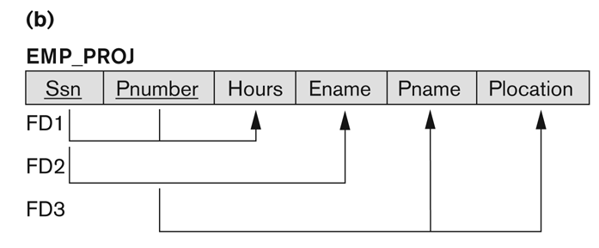
Second Normal Form
In this example, {Ssn, Pnummber} -> Hours is a fully dependency
However, the dependency {Ssn, Pnumber}->Ename is partial because Ssn->Ename holds

Slide 38
Second Normal Form
A relation schema R is in second normal form (2NF) if every non-prime attribute A in R is fully functionally dependent on the primary key
A functional dependency X->Y is a partial dependency if some attribute A belong X can be removed from X and the dependency still holds

Slide 39
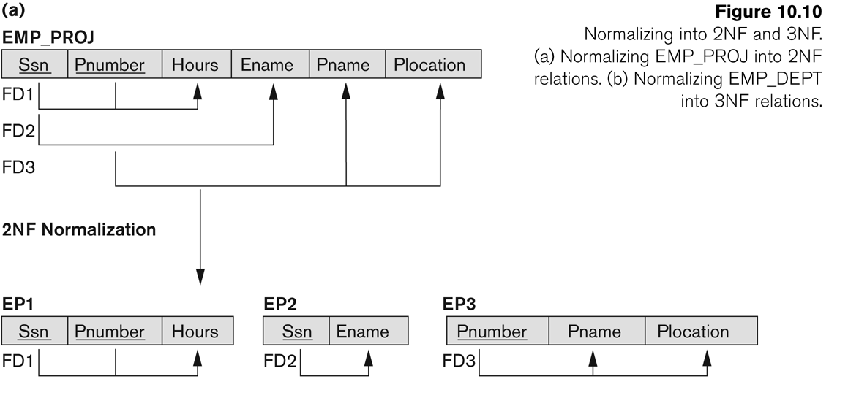
Second Normal Form

Slide 40
Third Normal Form
A relation schema R is in third normal form (3NF) if it is in 2NF and no non-prime attribute A in R is transitively dependent on the primary key
  Transitive functional dependency: a FD X -> Z that can be derived from two FDs X -> Y and Y -> Z

Slide 41
Third Normal Form
Examples:
  SSN -> DMGRSSN is a transitive FD
    Since SSN -> DNUMBER and DNUMBER -> DMGRSSN hold
  SSN -> ENAME is non-transitive
    Since there is no set of attributes X where SSN -> X and X -> ENAME

Slide 42
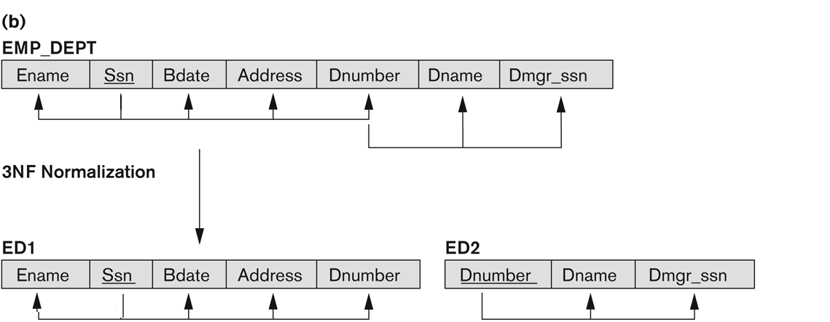
Third Normal Form

Slide 43
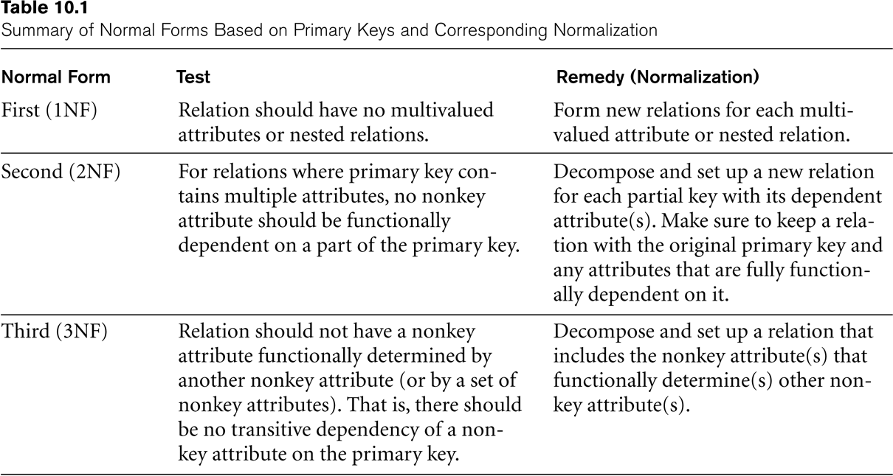
SUMMARY OF NORMAL FORMS based on Primary Keys

Slide 44
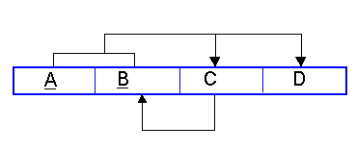
BCNF:
Boyce Codd Normal Form (BCNF) is considered a special condition of third Normal form. A table is in BCNF if every determinant is a candidate key. A table can be in 3NF but not in BCNF. This occurs when a non key attribute is a determinant of a key attribute. The dependency diagram may look like the one below
The table is in 3NF. A and B are the keys and C and D depend on both A and B. There are no transitive dependencies existing between the non key attributes, C and D.
The table is not in BCNF because a dependency exists between C and B. In other words if we know the value of C we can determine the value of B.

Slide 45
EXAMPLE
If we know the Student Number and Teacher Code we know the Offering (class) the student is in. We also know the review date for that student and teacher (Student progress is reviewed for that class by the teacher and student).
S_Num | T_Code | Offering# | Review Date
123599 | FIT104 | 01764 | 2nd March
123599 | PIT305 | 01765 | 12th April
123599 | PIT107 | 01789 | 2nd May
346700 | FIT104 | 01764 | 3rd March
346700 | PIT305 | 01765 | 7th May

Slide 46
EXAMPLE
The dependencies are
S_Num, T_Code Offering#, Review Date which means that the table is in third normal form. The table is not in BCNF as if we know the offering number we know who the teacheris. Each offering can only have one teacher! Offering# T_Code
A non key attribute is a determinant.
If we look at the table we can see a combination of T_Code andOffering# is repeated several times. eg FIT104 and 01764.

Slide 47
EXAMPLE
Converting to BCNF
1 | The determinant, Offering#, becomes part of the key and the dependant attribute T_Code, becomes a non key attribute. So the Dependency diagram is now S_Num, Offering# →€T_Code, Review Date
2 | There are problems with this structure as T_Code is now dependant on only part of the key. This violates the rules for 2NF, so the table needs to be divided with the partial dependency becoming a new table. The dependencies would then be S_Num, Offering# →€Review Date Offering# →€T_Code
3 | The original table is divided into two new tables. Each is in 3NF and in BCNF.

Slide 48
STUDENTREVIEW
S_Num | Offering# | Review Date
123599 | 01764 | 2nd March
123599 | 01765 | 12th April
123599 | 01789 | 2nd May
346700 | 01764 | 3rd March
346700 | 01765 | 7th May
OFFERING TEACHER
Offering# | T_Code
01764 | FIT104
01765 | PIT305
01789 | PIT107

